Slide 1
Requirement Engineering
Requirements Engineering (RE) refers to the process of defining, documenting, and maintaining requirements in the engineering design process.
Requirement Engineering Process
It is a four-step process, which includes -
Feasibility Study
Requirement Elicitation and Analysis
Software Requirement Specification
Software Requirement Validation

Slide 2
Requirement Engineering is the process of
finding requirements,
analyzing them,
documenting them,
validating them,
and managing changes in them.

Slide 3
Objectives of Requirement Engineering
Understand customer needs.
Document requirements clearly.
Remove ambiguities.
Avoid misunderstandings.
Reduce development cost.
Increase customer satisfaction.

Slide 4
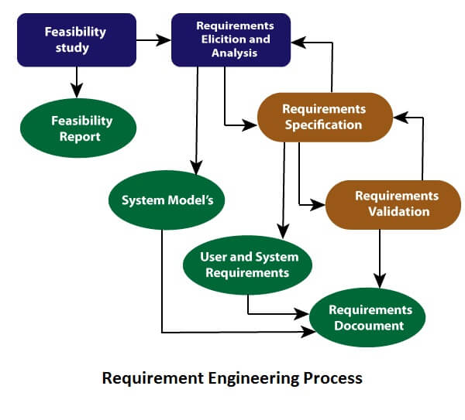

Slide 5
Feasibility Study
The objective behind the feasibility study is to create the reasons for developing the software that is acceptable to users, flexible to change and conformable to established standards.
Types of Feasibility:
Technical Feasibility: evaluates the current technologies, which are needed to accomplish customer requirements within the time and budget.
Operational Feasibility: assesses the range in which the required software performs a series of levels to solve business problems and customer requirements.
Economic Feasibility: Economic feasibility decides whether the necessary software can generate financial profits for an organization.

Slide 6
Technical Feasibility
College wants:
Face Recognition Attendance System.
Questions:
Do we have AI expertise?
Do we have required hardware?
Do we have required software?
If yes,
technically feasible.

Slide 7
Operational Feasibility:
Operational Feasibility checks whether the proposed software will work properly in the organization and whether the users are willing and able to use it.
Can this software solve the user's problem in the real working environment?
Question:
Will users actually use this system?
Example
College develops ERP.
Are teachers willing to enter attendance online?
Can office staff use the software?
Does the software actually reduce paperwork?

Slide 8
Questions asked in Operational Feasibility
Will the users accept the system?
Will the software solve the business problem?
Can employees use the system easily?
Does the organization have the necessary procedures to use the system?
Will the software improve the existing process?

Slide 9
Economic Feasibility:
Is the project financially beneficial?
Example
Software Cost:
₹50 Lakhs.
Expected Benefit:
₹5 Lakhs.
Should company develop?
No.

Slide 10
Requirement Elicitation and Analysis
This is also known as the gathering of requirements from stakeholders.
Here, requirements are identified with the help of customers and existing systems processes, if available.
Analysis of requirements starts with requirement elicitation.
The requirements are analyzed to identify inconsistencies, defects, omission, etc.

Slide 11
Techniques of Requirement Elicitation
1. Interview
Developer directly meets stakeholders.
Example
Developer asks supermarket owner:
How many products?
How is billing done?
Do you need barcode scanning?
Advantages
Detailed information
Immediate clarification
Disadvantages
Time consuming
Different stakeholders may give different answers

Slide 12
Techniques of Requirement Elicitation
2. Questionnaire
Prepare a list of questions.
Example
Do you need online payment?
Do you need inventory reports?
Do you need supplier management?
Advantages
Easy for many users.
Disadvantages
Users may not answer properly.

Slide 13
Techniques of Requirement Elicitation
3. Observation
Observe how the current system works.
Example
Observe supermarket billing.
Developer notices:
Billing takes 5 minutes.
Stock is maintained manually.
This helps identify requirements.
Advantages
Real requirements are discovered.
Disadvantages
Time consuming.

Slide 14
Techniques of Requirement Elicitation
4. Brainstorming
Multiple stakeholders discuss ideas.
Example
Owner says:Need reports.
Cashier says:Need faster billing.
Inventory Manager says:Need low stock alerts.
Together, requirements are generated.
Advantages
Generates many ideas.
Disadvantages
Difficult to manage large groups.

Slide 15
Techniques of Requirement Elicitation
5. Prototyping
Develop sample screens.
Example
Create:
Login Page
Billing Page
Customer says:
Add barcode scanner.
Add discount feature.
Requirements become clearer.
Advantages
Easy for customer to understand.
Disadvantages
Time consuming.

Slide 16
Techniques of Requirement Elicitation
6. Domain Analysis
Study similar systems.
Example
Developing Grocery System.
Study:
D-Mart Software
Reliance Smart Software
Learn common features.

Slide 17
Requirement Analysis
After collecting requirements, we cannot immediately start coding.
Because requirements may contain:
Errors
Conflicts
Missing information
Duplicate requirements
Therefore, we analyze them.
Requirement Analysis is the process of examining, organizing, refining, and resolving conflicts among requirements.

Slide 18
Requirement Analysis Example
Conflicting Requirements
Owner: Only Admin can delete products.
Cashier: I also want to delete products.
Analysis resolves it.
Ambiguous Requirement
Customer:System should be fast.
What does "fast" mean? 1 sec? 5 sec? 10 sec?
Requirement is unclear.
Analysis clarifies it.
Incomplete Requirement
Customer :I need billing.
Cash payment? UPI? Credit card? Discount?
Requirement is incomplete.

Slide 19
Activities in Requirement Analysis
Classify Requirements
↓
Prioritize Requirements
↓
Remove Conflicts
↓
Remove Ambiguities
↓
Create Models

Slide 20
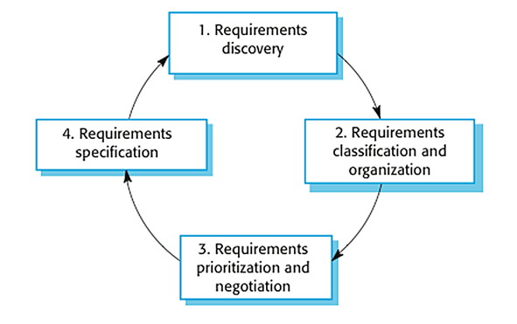
Requirement Elicitation and Analysis

Slide 21
Software Requirements
Broadly software requirements should be categorized in two categories:
Functional Requirements
Non Functional Requirements

Slide 22
Functional Requirements
Requirements, which are related to functional aspect of software fall into this category.
They define functions and functionality within and from the software system.
Examples -
Search option given to user to search from various invoices.
User should be able to mail any report to management.
Users can be divided into groups and groups can be given separate rights.
Should comply business rules and administrative functions.
Software is developed keeping downward compatibility intact.

Slide 23
Non-Functional Requirements
Requirements, which are not related to functional aspect of software, fall into this category. They are implicit or expected characteristics of software, which users make assumption of.
Non-functional requirements include -
  Security
  Logging
  Storage
  Configuration
  Performance
  Cost
  Interoperability
  Flexibility
  Disaster recovery
  Accessibility

Slide 24
Requirement Elicitation and Analysis
Requirement Elicitation Techniques
Interviews
Surveys
Questionnaires
Task analysis
Domain Analysis
Brainstorming
Prototyping
Observation

Slide 25
Requirements Analysis
Requirements analysis or requirements engineering is a process used to determine the needs and expectations of a new product.
It involves frequent communication with the stakeholders and end-users of the product to define expectations, resolve conflicts, and document all the key requirements.

Slide 26
Requirements Analysis Process
A requirements analysis process involves the following steps:
  Identify Key Stakeholders and End-Users
  Capture Requirements
  Categorize Requirements
  Interpret and Record Requirements
  Sign off

Slide 27
Requirements Analysis Process
Identify Key Stakeholders and End-Users:
The first step of the requirements analysis process is to identify key stakeholders who are the main sponsors of the project.
They will have the final say on what should be included in the scope of the project.
Next, identify the end-users of the product. Since the product is intended to satisfy their needs, their inputs are equally important.

Slide 28
Requirements Analysis Process
Capture Requirements:
Ask each of the stakeholders and end-users their requirements for the new product. some of the requirements analysis techniques are,
1. Hold One-on-One Interviews
2. Use Focus Groups
3. Utilize Use Cases
4. Build Prototypes

Slide 29
Requirements Analysis Process
Categorize Requirements:
Since requirements can be of various types, they should be grouped to avoid confusion. Requirements are usually divided into four categories:
Functional Requirements - Functions the product is required to perform.
Technical Requirements - Technical issues to be considered for the successful implementation of the product.
Transitional Requirements - Steps required to implement a new product smoothly.
Operational Requirements - Operations to be carried out in the backend for proper functioning of the product.

Slide 30
Requirements Analysis Process
Interpret and Record Requirements
Once the requirements are categorized, determine which requirements are actually achievable and document each one of them.
Some techniques to analyze and interpret requirements are,
Define Requirements Precisely
Prioritize Requirements
Carry Out an Impact Analysis
Resolve Conflicts
Analyze Feasibility

Slide 31
Requirements Analysis Process
Sign off
Once a final decision is made on the requirements, ensure that you get a signed agreement from the key stakeholders.
This is done to ensure that there are no changes or uncontrolled growth in the scope of the project.

Slide 32
Software Requirement Specification
Software requirement specification is a kind of document which is created by a software analyst after the requirements collected from the various sources.
The requirement received by the customer written in ordinary language.
It is the job of the analyst to write the requirement in technical language so that they can be understood and beneficial by the development team.

Slide 33
Software Requirement Specification
The models used at this stage include
Data Flow Diagrams: Data Flow Diagrams (DFDs) are used widely for modeling the requirements. DFD shows the flow of data through a system.
Data Dictionaries: Data Dictionaries are simply repositories to store information about all data items defined in DFDs.
Entity-Relationship Diagrams: Another tool for requirement specification is the entity-relationship diagram, often called an "E-R diagram."
It is a detailed logical representation of the data for the organization and uses three main constructs i.e. data entities, relationships, and their associated attributes.

Slide 34
Software Requirement Validation
After requirement specifications developed, the requirements discussed in this document are validated.
Requirements can be the check against the following conditions -
If they can practically implement
If they are correct and as per the functionality and specially of software
If there are any ambiguities
If they are full
If they can describe

Slide 35
Software Requirement Validation
Requirements Validation Techniques
Requirements Reviews/inspections: systematic manual analysis of the requirements.
Prototyping: Using an executable model of the system to check requirements.
Test-case generation: Developing tests for requirements to check testability.
Automated consistency analysis: checking for the consistency of structured requirements descriptions.

Slide 36
Software Requirement Management
Requirement management is the process of managing changing requirements during the requirements engineering process and system development.

Slide 37
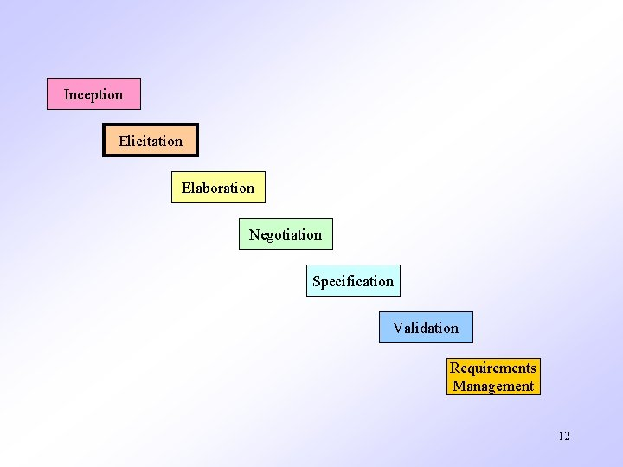
Requirement Engineering task

